Slide 1

JAVA BASICS
Soni Ishwarya v
Assistant professor
soniishwarya.v@vit.ac.in

Slide 2
JAVA
James Gosling developed “OAK” in 1991 at Sun Microsystems, Inc.
“Oak” was renamed as “JAVA” in 1995

Slide 3
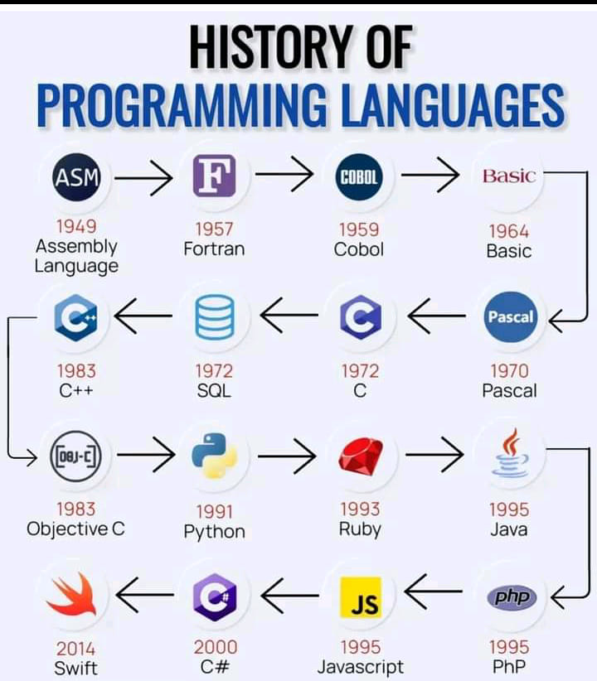

Slide 4
JAVA
Java is both a compiled and an interpreted language
The source code is first compiled into a binary byte-code.
This byte-code runs on the Java Virtual Machine (JVM), which is usually a software-based interpreter.
Source Program
Compiler
(Compilation)
Byte Code
JVM
(Running/ Execution)
Editor

Slide 5
BYTECODE
In Java, bytecode is the intermediate, platform-independent representation of a Java program. When you write and compile Java source code (.java file), the Java compiler (javac) does not translate it directly into machine code specific to the operating system and hardware.
Instead, it compiles the source code into bytecode instructions, stored in a .class file.

Slide 6
JVM
JVM (Java Virtual Machine) is an abstract machine.
JVM is the runtime environment where Java bytecode is executed.
It provides the environment for running Java programs by converting bytecode into machine-specific instructions.
JVM loads, verifies and executes the code.
JVM is platform dependent.

Slide 7
Feature | JVM | JRE | JDK
Purpose | Runs Java bytecode. | Runs Java applications. | Develops, compiles, and runs Java programs.
Includes | Core runtime environment. | JVM + libraries + supporting files. | JRE + development tools like compiler, debugger.
Use Case | Execute bytecode at runtime. | Execute pre-compiled Java applications. | Write, compile, and debug Java programs.
Who uses it? | End-users running Java programs. | End-users running Java programs. | Developers creating Java applications.
Tools Included? | No | No | Yes (javac, javadoc, jar).

Slide 8
JAVA Features
Simple
Secure
Portable
Robust
Object-Oriented
JAVA Features
Multi-Threaded
Dynamic
Architectural-Neutral

Slide 9
JAVA Features
Portability: The codes are executable among different CPUs and Operating Systems- Platform Independent.
Security: Computer might download malicious programs. Java ensures the access limit within Java Execution Environment
Simple: Easy to learn and use
Robust: Error checking at compile and run time. Utilizes strong Memory management problem – automatic deallocation and garbage collection for unused objects

Slide 10
JAVA Features
Multithreaded: Perform simultaneous tasks. Java run-time system provides solution for multiple synchronization
Architecture-Neutral: OS or processor upgrade makes a program mal-function. JVM creates a Java program as “write – once; run – anywhere, anytime and forever.”
Dynamic: Have run-time type information i.e., verify and resolves accesses to objects at run time.
Object-Oriented: Object model is simple and easy to extend.

Slide 11
WHY USE JAVA?
Java works on different platforms (Windows, Mac, Linux, Raspberry Pi, etc.)
It is one of the most popular programming languages in the world
It has a large demand in the current job market
It is easy to learn and simple to use
It is open-source and free
It is secure, fast and powerful

Slide 12
WHY USE JAVA?
It has huge community support (tens of millions of developers)
Java is an object oriented language which gives a clear structure to programs and allows code to be reused, lowering development costs
As Java is close to C++ and C#, it makes it easy for programmers to switch to Java or vice versa

Slide 13
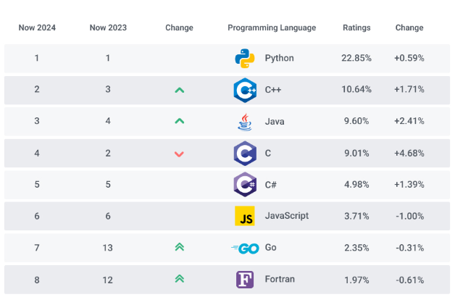

Slide 14
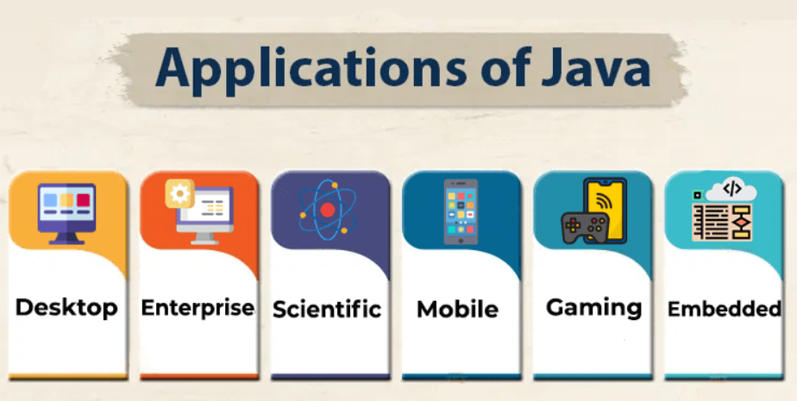

Slide 15
LIMITATIONS
Performance: Java programs take a much longer time to run compared to C/C++.
Memory: Since Java Programs run on top of Java Virtual Machine, it consumes more memory.
Cost: Since memory and processing requirements increase cost also increases.

Slide 16
TERMINOLOGY
Class: Class is a blueprint which defines some properties and behaviours.
Object: An object is an instance of a class which has those properties and behaviors attached.
Method: Block of code which runs when it is called.
Package: A package in Java is used to group related classes.

Slide 17
PROGRAM PARADIGMS
Program Paradigms
Process-oriented Model
Ex: C
Object-oriented
Ex: Java, C++

Slide 18
Parameter | Procedural Programming | Object Oriented Programming
Definition | This programming language makes use of a step-by-step approach for breaking down a task into a collection of routines (or subroutines) and variables by following a sequence of instructions. | This programming language uses objects and classes for creating models based on the real-world environment.
Security | Procedural Programming does not offer any method of hiding data. | Hiding data is possible with Object Oriented Programming due to the abstraction.
Approach | The Procedural Programming follows a Top-Down approach. | The Object Oriented Programming follows a Bottom-Up approach.
Reusability of Code | No feature of reusing codes is present in Procedural Programming. | Object Oriented Programming offers the feature to reuse any existing codes in it by utilizing a feature known as inheritance.

Slide 19
1. OOP PRINCIPLES - ABSTRACTION
Is a concept of OOPs that shows only the essential attributes and hides unnecessary information.

Slide 20
2. OOP PRINCIPLES - ENCAPSULATION
Encapsulation is the process of bundling data (fields or variables) and methods (functions) that operate on the data into a single unit, usually a class.
It also involves restricting direct access to some of the object's components, exposing only necessary details through controlled access mechanisms.

Slide 21
3. OOP PRINCIPLES - INHERITANCE
Inheritance allows a class (called a child class or subclass) to inherit the properties and behaviors (fields and methods) of another class (called a parent class or superclass).
This promotes code reuse and supports a hierarchical classification of objects.
Grand Father
(Height)
Grand Mother
(Skin Colour)
Super Class
Father
( Knowledge)
Mother
(H/SC+ Music)
Son
(K + Music + Sports)
Sub Class

Slide 22
4. OOP PRINCIPLES - POLYMORPHISM
Polymorphism – many forms
Polymorphism means "many forms" and is a key concept in Object-Oriented Programming (OOP).
It allows objects to be treated as instances of their parent class rather than their actual class

Slide 23
PROGRAMMING CONSTRUCTS
class first
{
}
class – Java Keyword
first – Identifier for ‘first’ class
Class Definition with members along with access specifier (default or public)

Slide 24
PROGRAMMING CONSTRUCTS
public class first
{
public static void main(String args[])
{
}
}
Access Specifier – Code from outside class can access this method
Call this method, without creating an object of ‘first’ class
Return value of this method
Program Entry Point – First method to be executed in the Compilation Unit
Array of String Object – args

Slide 25
EXAMPLE
public class first
{
public static void main(String args[])
{
System.out.println (“Hello VIT Students”);
}
}
Display the String and values
Predefined Java Class to access this method
Output stream to standard output device

Slide 26
Can class name and project name be same? | YES, but not encouraged
Can class name and object name be same? | YES

Slide 27
Basic Constructs
Identifiers
Datatypes
Literals
Comments
Operators
Separators
Keywords

Slide 28
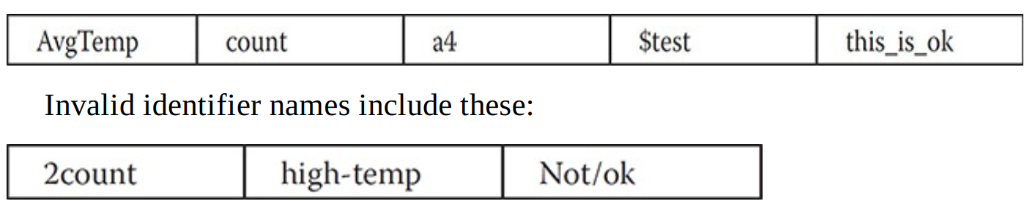
Identifiers
Naming concept for Class / Methods / Variables
Sequence of Alpha- Numeric
Special Symbol: $ and _ (Underscore)
Case Sensitive
Should not start with Number

Slide 29
Find Valid and Invalid Identifiers
Total
Frame2
TOTAL
$rs
5test
var_1_int
Ticket-7
Course_1007
#java

Slide 30
Data Types

Slide 31
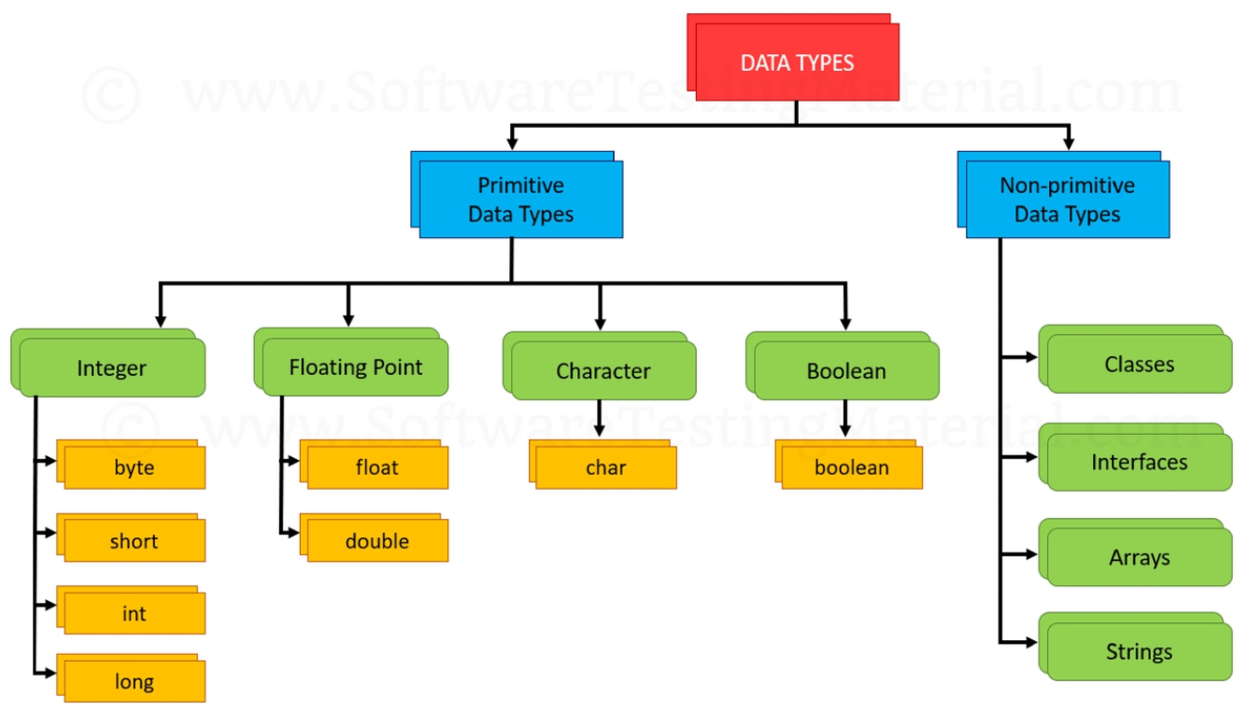
Data Types

Slide 32
Primitive Data Types
Each variable and expression has a data type.
Data Types
Integer (int, short, long, byte) – Signed whole number
Floating Point (float, double) – number with fractional portions
Character (char) – Symbols in a character set
Boolean (boolean) – true/false value

Slide 33
Integer
byte (8 bits)
Range: -128 to 127
File Streaming purpose
short (16 bits)
Rarely used
Range: –32,768 to 32,767

Slide 34
Integer
int (32 bits)
Range: –2,147,483,648 to 2,147,483,647
Commonly used data type under Integer
long (64 bits)
Range: larger than int
Used where value is more than int
Ex: Number of vehicles that crossed a signal per month

Slide 35
Character
Unicode to represent all the characters in natural languages
16 bits
Range: 0 to 65,536

Slide 36
Comments
Single line (\\)
Multiple lines (\*………….*\)

Slide 37
Separators
; (Semicolon) → statement end
( ) (parenthesis) → list of parameters - (String args[])
{ } (Braces) → code block (class/method)
[ ] (Brackets) → Array index - args[i]
, (comma) → identifier separation in the variable declaration statement
. (period) → Access methods from packages/sub-packages/class objects
: (colon) → Method access from its class

Slide 38
Keywords
61 keywords
Ex: new, int, char, private, class, public, this, void, try, if, while, for etc
All keywords are reserved words but not all reserved words are keywords
Reserved words – cannot be used as identifiers
They cannot be used as a variable

Slide 39
Identifiers/Keywords
Identifiers | Keywords
Name defined by user | Reserved keywords –known by the compiler
Contains letters, digits and underscore | Contains only letters
Examples : sum, power, result | Examples: for, if ,else, break

Slide 40
Variables
A place where values are stored.
Eg:- a = 50;

Slide 41
Operators

Slide 42
Arithmetic Operators
Operator | Meaning | Example | Result
+ | Addition | 5 + 5 | 10
- | Subtraction | 10 - 5 | 5
* | Multiplication | 2 * 8 | 16
/ | Division | 20 / 4 | 5
% | Modulus | 22 % 4 | 2

Slide 43
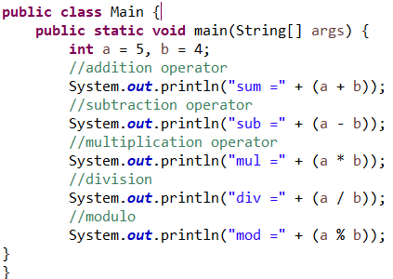

OUTPUT

Slide 44
Augmented (compound) Assignment Operators
Arithmetic operators (+, -, *, /, %) are combined with assignment (=) operator
Operator | Meaning | Example | Result | Expansion
+= | Addition Assignment | n = 10 n += 1 | 11 | n = n + 1
-= | Subtraction Assignment | n = 10 n -= 1 | 9 | n = n - 1
*= | Multiplication Assignment | n = 10 n *= 2 | 20 | n = n * 1
/= | Division Assignment | n = 10 n /= 5 | 2 | n = n / 1
%= | Modulus Assignment | n = 10 n %= 3 | 1 | n = n % 1

Slide 45
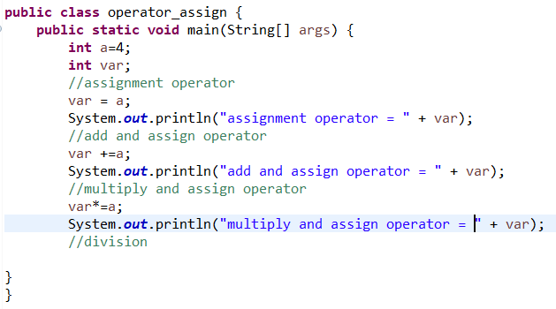

OUTPUT

Slide 46
Relational Operator
Operator | Meaning | Meaning | Example | Result
A = true, B = false
== | Equal |  | A == B | false
!= | Not Equal |  | A != B | true
X = 2, Y = 4
> | Greater than |  | X > Y | false
< | Less than |  | X < Y | true
<= | Less than or equal |  | X <= Y | true
>= | Greater than or equal |  | X >= Y | false

Slide 47
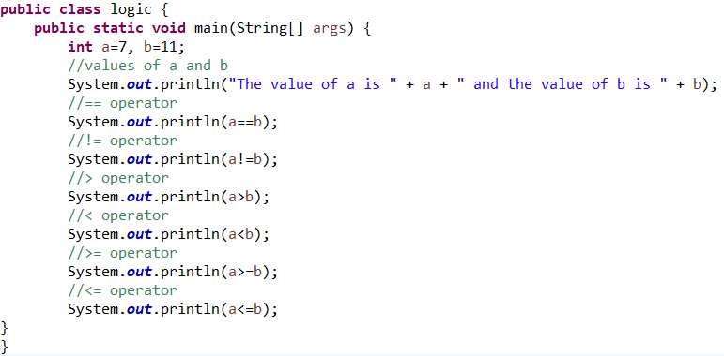

Slide 48
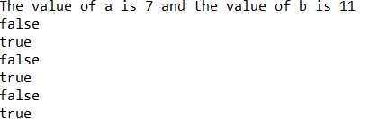
OUTPUT

Slide 49
Logical Operator
Operator | Meaning | Meaning | Example | Result
A = true, B = false
& | Logical AND |  | A & B | False
| | Logical OR |  | A | B | True
^ | Logical XOR |  | A ^ B | True
|| | Short Circuit OR |  | A || B | True
&& | Short circuit AND |  | A && B | False
! | Logical Unary NOT |  | !A | False

Slide 50
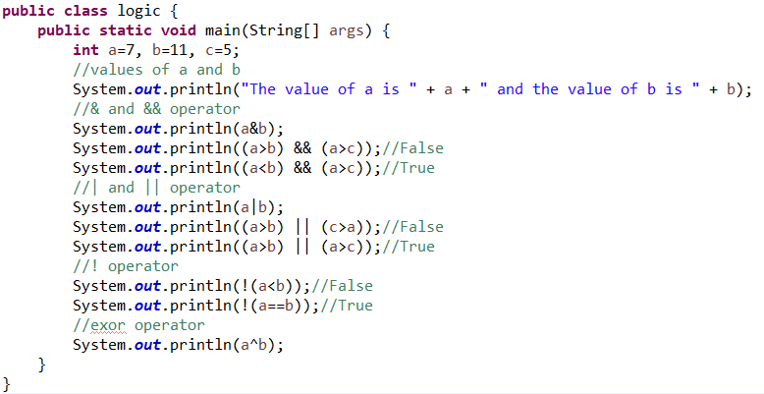

Slide 51
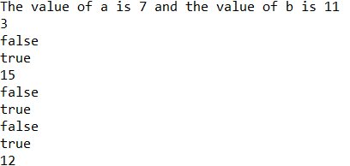
OUTPUT

Slide 52
Increment and Decrement Operator
Operator | Meaning | Example | Result | Expansion
++var | Pre increment | n = 10 n = ++n | 11 | n = n + 1 n = n
var++ | Post increment | n = 10 n = n++ | 10 | n = n n = n + 1
--var | Pre decrement | n = 10 n = --n | 9 | n = n - 1 n = n
var-- | Post decrement | n = 10 n = n-- | 10 | n = n n = n - 1

Slide 53
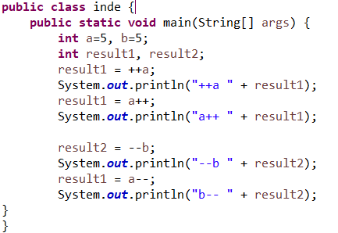

OUTPUT

Slide 54
Bitwise Operator
Operator | Meaning | Example | Result
~ | Bitwise Unary NOT | A = 1 ~A | 0
& | Bitwise AND | A = 0, B = 0 A & B | 0
| | Bitwise OR | A = 1, B = 0 A | B | 1
^ | Bitwise Exclusive OR | A = 1, B = 0 A ^ B | 1
>> | Shift Right
<< | Shift Left

Slide 55
Bitwise Operator
Operator | Meaning
&= | Bitwise AND Assignment
|= | Bitwise OR Assignment
^= | Bitwise Exclusive OR Assignment
>>= | Shift Right Assignment
<<= | Shift Left Assignment

Slide 56
The ? Operator
Ternary (three) operator
Syntax
Expression1 ? Expression2 : Expression3;
Expression1 is true → Expression2 will be executed → Else, Expression3 will be executed

Slide 57
Operator Precedence
++ (postfix), --(postfix), ++(prefix), --(prefix),
~, !, +(unary), -(unary)
*, /, %
+, -, >>, >>>, <<
>, >=, <, <=
==, !=
&, |, ^, &&, ||, ?:,
Int a = 10, b = 2, c = 20;
Int t = a + b * c

Slide 58
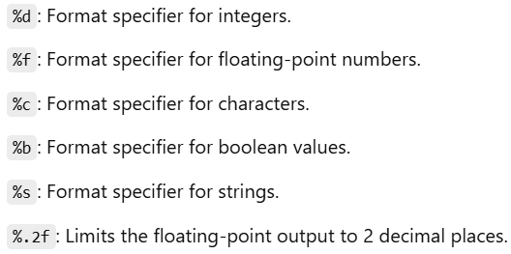

Slide 59
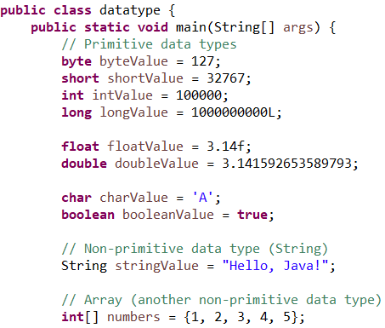

Slide 60
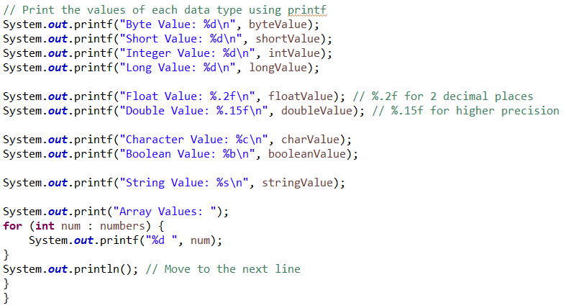

Slide 61
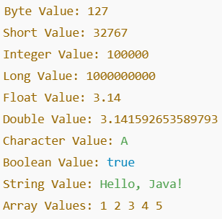
OUTPUT

Slide 62
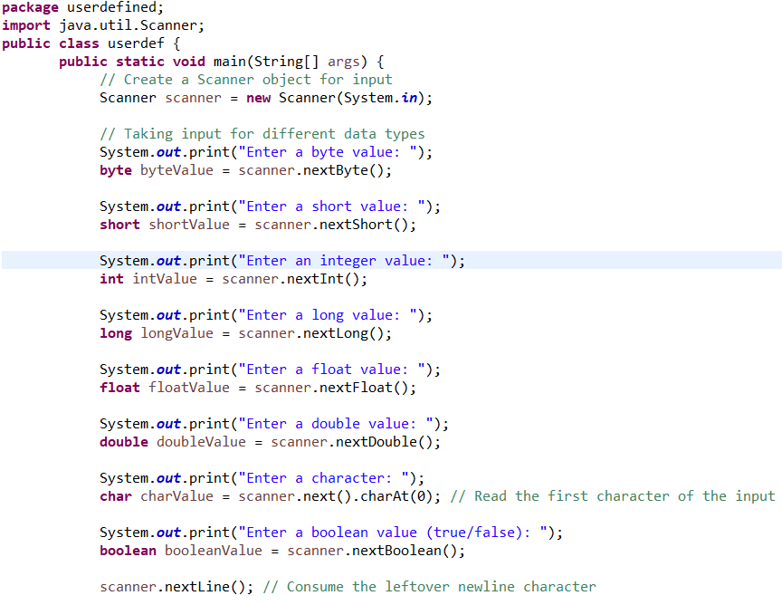

Slide 63
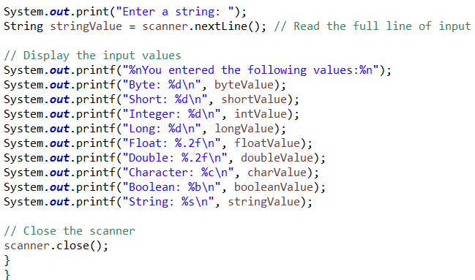

Slide 64
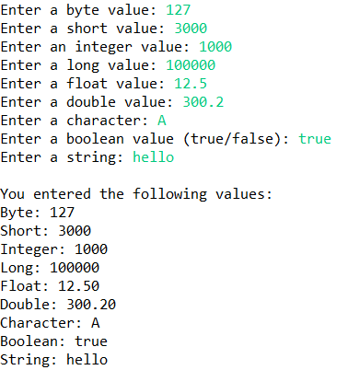

Slide 65
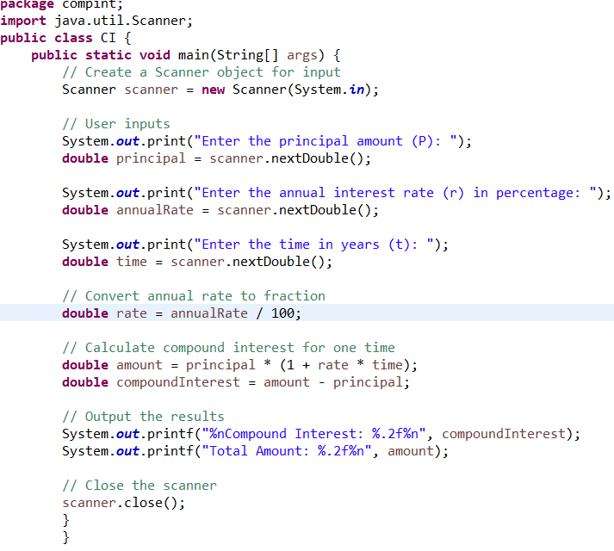

Slide 66
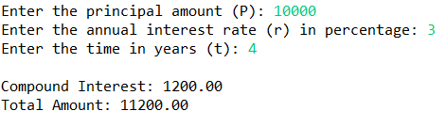
OUTPUT

Slide 67
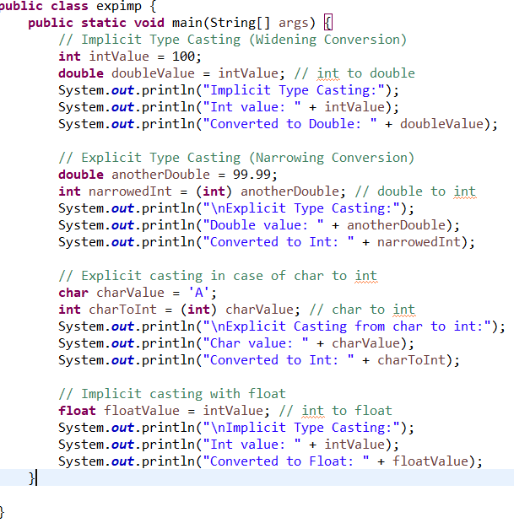

Slide 68
